Slide 1

7th Grade Math
Unit 10, Lesson 8 Solving Real-World Problems with Two-Step Equations Volume 2, pg. 128

Slide 2


Benchmark
MA.7.AR.2.2
Write and solve two-step equations in one variable within a mathematical context or real-world context, where all terms are rational numbers.
volume 2, pg. 128

Slide 3
Integrated Mathematical Thinking and Reasoning Standards
MA.K12.MTR.1.1 Actively participate in effortful learning both individually and collectively.
MA.K12.MTR.2.1 Demonstrate understanding by representing problems in multiple ways.
MA.K12.MTR.3.1 Complete tasks with mathematical fluency.
MA.K12.MTR.4.1 Engage in discussions that reflect on the mathematical thinking of self and others.
MA.K12.MTR.5.1 Use patterns and structure to help understand and connect mathematical concepts.
MA.K12.MTR.6.1 Assess the reasonableness of solutions.
MA.K12.MTR.7.1 Apply mathematics to real-world contexts.
volume 2, pg. 128

Slide 4

Learning Targets
I can solve two-step equations within a real-world context.
I can relate the solution of an equation representing a real-world context to the context.
volume 2, pg. 128

Slide 5

Warm-Up
volume 2, pg. 129

Slide 6
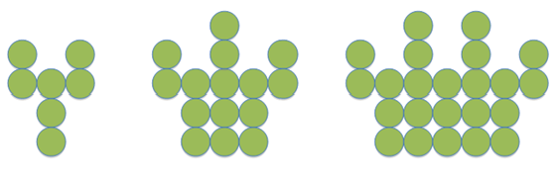
10.8.1 Warm-Up: Number Patterns
A pattern is shown.
Describe how the pattern is changing in each step.
How many circles will be in the next step?
volume 2, pg. 129

Slide 7

Collaboration
volume 2, pg. 129

Slide 8

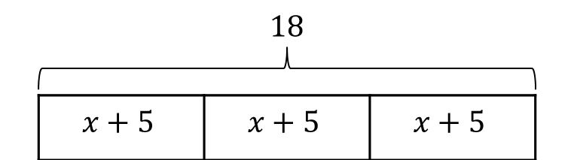
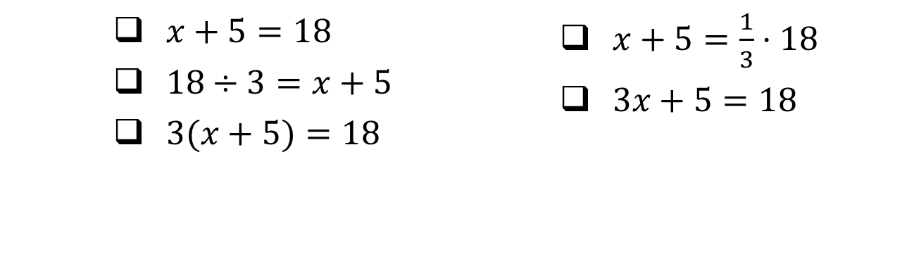
10.8.2 Collaboration: Matching Equations to Diagrams and Contexts
Equations can be represented using bar diagrams.
A bar diagram is shown.
Select all the equations that match the diagram.
volume 2, pg. 129

Slide 9
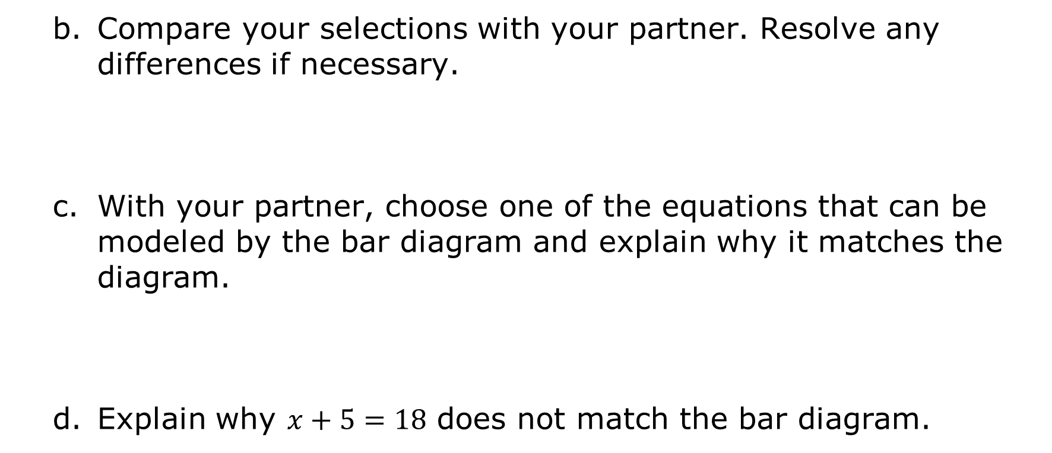
Compare your selections with your partner. Resolve any differences if necessary.
With your partner, choose one of the equations that can be modeled by the bar diagram and explain why it matches the diagram.
Explain why $x+5=18$ does not match the bar diagram.
volume 2, pg. 129

Slide 10
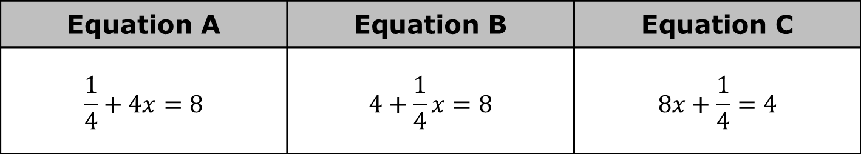
Equations can be used to represent real-world contexts.
Three equations are shown.
Equation A | Equation B | Equation C
$$\frac{1}{4}+4x=8$$ | $$4+\frac{1}{4}x=8$$ | $$8x+\frac{1}{4}=4$$
volume 2, pg. 130

Slide 11
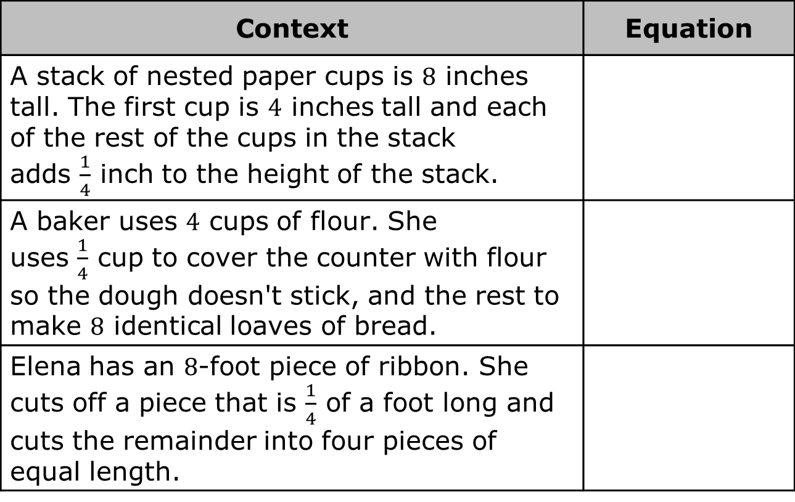
Work with your partner to determine which equation matches each context. Then, write each equation in the appropriate row.
Context | Equation
A stack of nested paper cups is $8$ inches tall. The first cup is $4$ inches tall and each of the rest of the cups in the stack adds $\frac{1}{4}$ inch to the height of the stack.
A baker uses $4$ cups of flour. She uses $\frac{1}{4}$ cup to cover the counter with flour so the dough doesn't stick, and the rest to make $8$ identical loaves of bread.
Elena has an $8$-foot piece of ribbon. She cuts off a piece that is $\frac{1}{4}$ of a foot long and cuts the remainder into four pieces of equal length.
volume 2, pg. 130

Slide 12
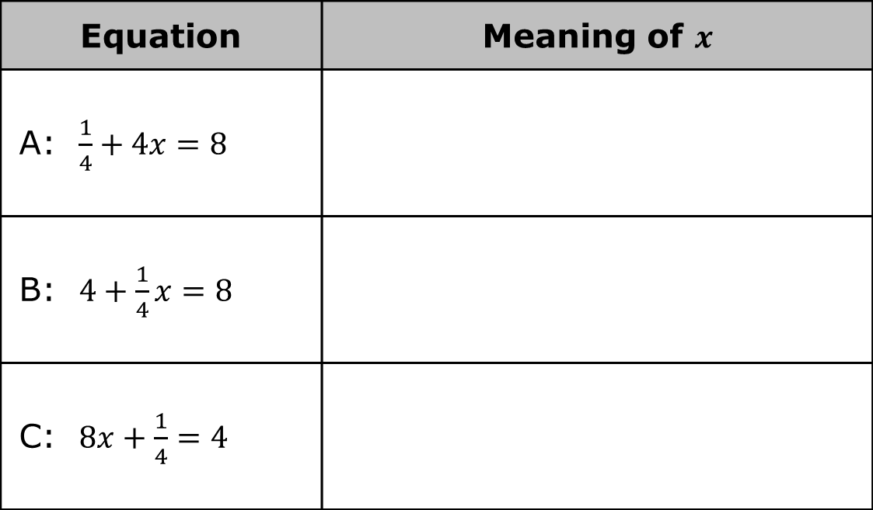
With your partner, discuss what the variable 𝑥 represents in each of the equations. Then, write the meaning of 𝑥 in each equation based on the context it matches.
Equation | Meaning of $x$
A: $\frac{1}{4}+4x=8$
B: $4+\frac{1}{4}x=8$
C: $8x+\frac{1}{4}=4$
volume 2, pg. 130

Slide 13

Guided Instruction
volume 2, pg. 131

Slide 14
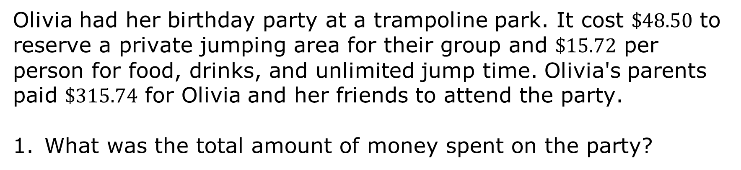
10.8.3 Guided Instruction: Relating Equations to Their Contexts
Olivia had her birthday party at a trampoline park. It cost $\$48.50$ to reserve a private jumping area for their group and $\$15.72$ per person for food, drinks, and unlimited jump time. Olivia's parents paid $\$315.74$ for Olivia and her friends to attend the party.
What was the total amount of money spent on the party?
volume 2, pg. 131

Slide 15
One of the costs depends on the number of people attending the party, while the other does not.
Which cost depends on the number of people who attend the party?
Which cost is the same regardless of how many people attend the party?
volume 2, pg. 131

Slide 16
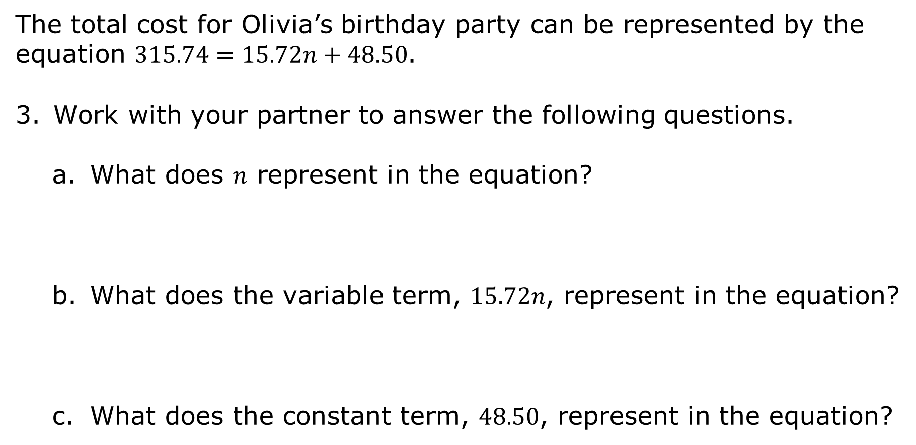
The total cost for Olivia’s birthday party can be represented by the equation $315.74=15.72n+48.50$.
Work with your partner to answer the following questions.
What does $n$ represent in the equation?
What does the variable term, $15.72n$, represent in the equation?
What does the constant term, $48.50$, represent in the equation?
volume 2, pg. 131

Slide 17
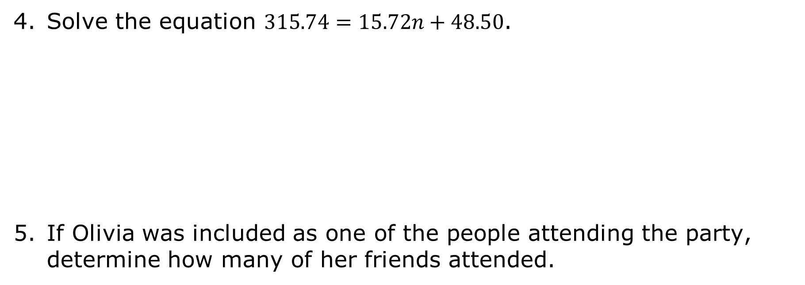
Solve the equation $315.74=15.72n+48.50$.
If Olivia was included as one of the people attending the party, determine how many of her friends attended.
volume 2, pg. 132

Slide 18

Guided Practice
volume 2, pg. 132

Slide 19

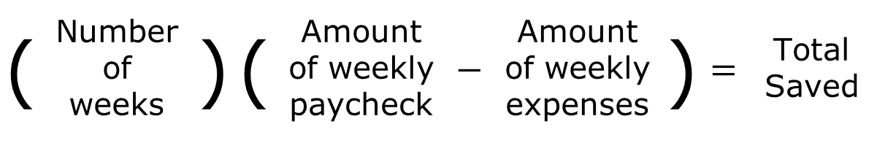
10.8.4 Guided Practice: Relating Equations to Their Contexts
Franco is saving money to take a trip to Cocoa Beach, Florida with his friends. Every week, he sets aside the same portion of his paycheck after taking out the $\$325$ he needs for his weekly expenses. After $11$ weeks, Franco has $\$489.94$ saved for his trip.
An equation can be created relating these quantities as described below.
Which of these quantities is unknown?
( | Number of weeks | ) | ( | Amount of weekly paycheck | $$−$$ | Amount of weekly expenses | ) | $$=$$ | Total Saved
volume 2, pg. 132

Slide 20
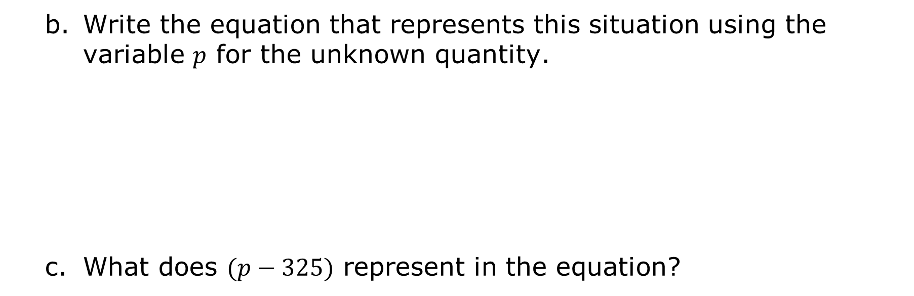
Write the equation that represents this situation using the variable $p$ for the unknown quantity.
What does $(p−325)$ represent in the equation?
volume 2, pg. 132

Slide 21
Solve the equation.
Explain what the solution means in this context.
volume 2, pg. 133

Slide 22

Try It
volume 2, pg. 133

Slide 23
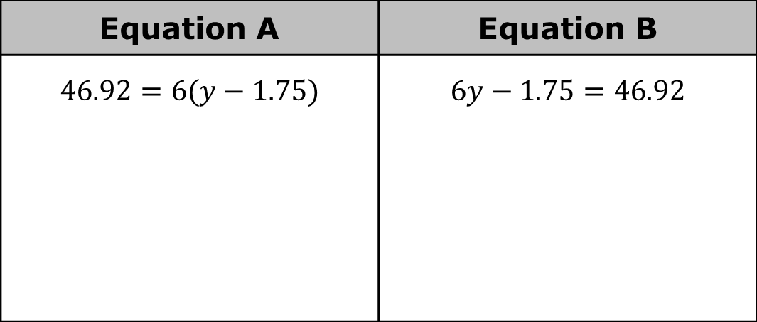
10.8.5 Try It: Relating Equations to Their Contexts
Work with your partner to complete the following.
Two equations are shown.
Solve both equations. Show your work.
Equation A | Equation B
$$46.92=6(y−1.75)$$ | $$6y−1.75=46.92$$
volume 2, pg. 133

Slide 24
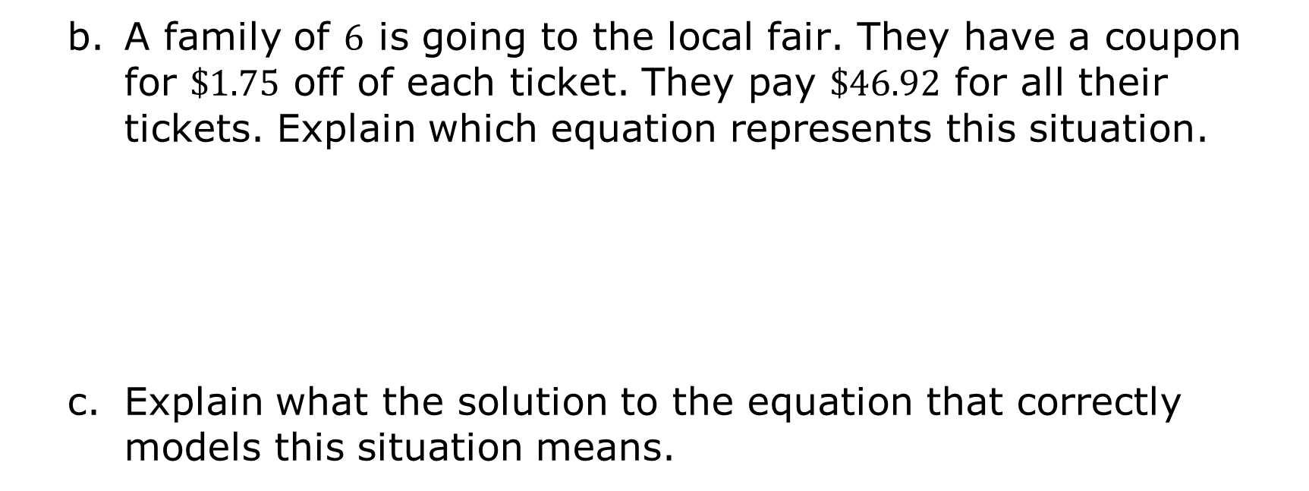
A family of $6$ is going to the local fair. They have a coupon for $\$1.75$ off of each ticket. They pay $\$46.92$ for all their tickets. Explain which equation represents this situation.
Explain what the solution to the equation that correctly models this situation means.
volume 2, pg. 133

Slide 25

Wrap-Up
volume 2, pg. 134

Slide 26

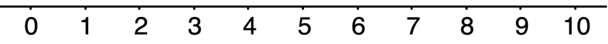
10.8.6 Wrap-Up: Reflection
Circle the value on the emoji scale that best represents your understanding of today’s lesson.
Briefly explain your choice.
volume 2, pg. 134

